Slide 1


Cloud Infrastructure Solution For Recipe Management

Slide 2

Problem Statement ?
Need a robust cloud infrastructure for storing, consolidating, and distributing automation recipes.
A recipe is a set of instructions that a robotic arm follows to complete tasks. These instructions can cover a variety of actions, from recognizing screws to unscrewing them, and picking up various components of a battery

Slide 3
Infrastructure Design Goals
Design a cloud solution to handle large and small recipe files efficiently, ensuring secure storage, easy distribution, and access control.
Storage: Efficient handling of large binary files (1+ GB) and small configuration files. Version control to track changes.
Consolidation: Zip files for easy distribution and secure storage.
Distribution: Ensure global delivery with secure access.
Security: Encrypt data during storage and transmission.
Network: VPN for secure on-premises and cloud communication.
Proposed Architecture Flow
Data Source
Store the Data
Process the Data
Store the Data
Transfer to Customer

Slide 4
Proposed Architecture Flow
Data Source
Store the Data
Process the Data
Store the Data
Transfer to Customer

Slide 5
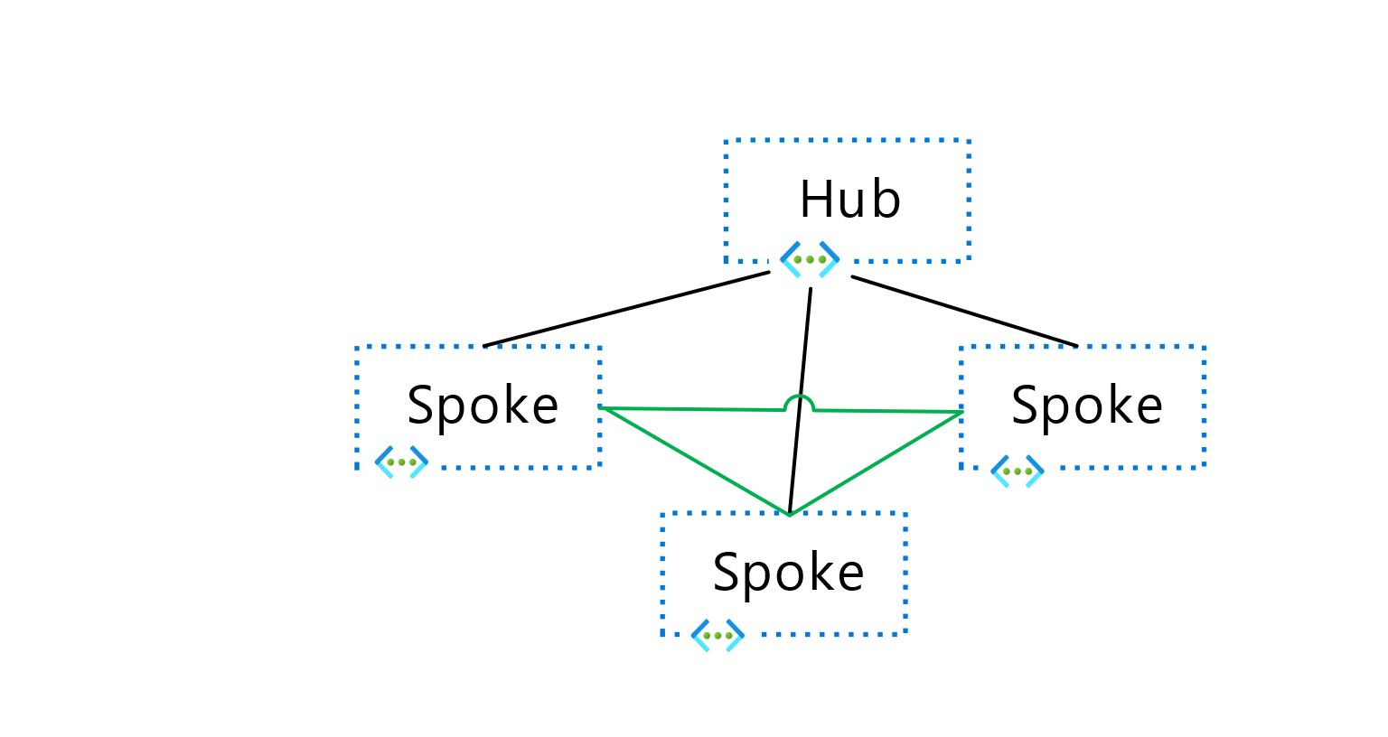
Proposed Architecture
Hub-and-Spoke Network:
Hub: Centralized resources like firewall, VPN gateway, monitoring.
Spokes: Isolated networks for storage, functions, CDN, and user portal,KeyVaults,IoT Hub & event grid.
Hub and Spoke network design will allow us to simplify security, improve scalability, manage costs more effectively, and ensure a flexible and robust architecture for handling large-scale data distribution

Slide 6
Detailed Architecture Components
Hub Network:
Azure Firewall: Controls traffic and enforces security policies.
VPN Gateway &Express route: Secure communication between on-premises and Azure.
Monitoring: Secure management and tracking.
Application Gateway : Used load balancing and web traffic management
Spoke Networks:
Azure IoT Hub: enables secure and scalable communication with IoT devices.
Event Grid: routing events from various sources to event handlers like Azure Functions or Webhooks
Storage: Azure Blob Storage with versioning.
Function: Azure Functions for automating file processing.
Content Delivery: Azure CDN for fast global access.
User Portal: Web infrastructure for authentication and access.
Azure KeyVault: To Store and Manage Keys & secrets.

Slide 7
Flow of User Access & File Management
User Authentication: Azure AD authenticates users, assigns roles.
Authorization: Role-based access control (RBAC) to Blob Storage.
Data Storage: Recipes stored securely in Blob Storage with versioning.
Automation: Azure Functions zip files for easier distribution.
Secure Distribution: Azure CDN delivers files globally with SAS tokens.
VPN Gateway: Secure access for on-premises systems.
Security Considerations
Azure AD Authentication: Ensures only authorized users can access the portal.
RBAC: Manages access to resources based on user roles.
Private Endpoints: Keeps internal communication secure.
VPN Gateway: Ensures encrypted communication between on-premises and Azure.
SAS Tokens: Temporary, secure access to recipe files.
Azure KeyVault: Store Sensitive Information.

Slide 8
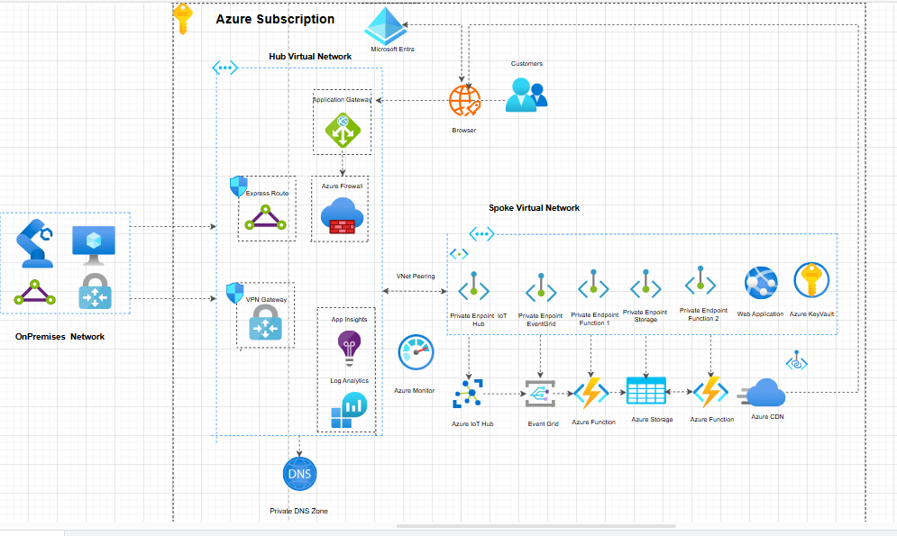
Complete Architecture Diagram

Slide 9
Benefits of This Architecture
Scalability: Easily expand as business grows with isolated spoke networks.
Security: Robust data protection with encryption, RBAC, and private endpoints.
Global Reach: Fast, reliable delivery of recipe files via Azure CDN.
Automation: Reduces manual work with Azure Functions for file zipping.
Comprehensive Monitoring: Centralized logging and alerting for performance and security.

Slide 10
Key Insights
Topic | Benefits | Potential Pitfalls | Important Considerations
Infrastructure as Code | Automation & Consistency Version Control Speed and agility | Complexity in large setup Security risk | Manage state properly Module code
IoT & Edge computing | Real time processing Bandwidth efficiency Scalability | Security Vulnerabilities Data privacy concerns Management complexity | Strong security measures. Data handling & privacy. Scalability & ease of maintenance.
Cost Calculation & Optimizations | Cost control Predictability Efficiency& Performance balance. | Over/under provisioning Hidden cost | Choose right sizing & plan Use reserved /spot instances. Monitor usage with cost management tools.

Slide 11
THANK YOU

